Slide 1
Vaccination Management System
Courses: Database Management System(Sessional)
Software Development with JAVA (Sessional)

Slide 2

Vaccination Management System
Course Teachers: Md. Shafiul Alam Forhad
Md. Atiqul Islam Rizvi
Sharmistha Chanda Tista
Md. Mynul Hasan
(Assistant Professor, Dept of CSE, CUET)
Presented By: Nazmus Sakib Md. Adil (2004117)
Trayee Das (2004118)
Enan Abrar (2004120)

Slide 3
Content
Introduction
Motivation
Project Overview
Objectives
Final Database Design
System Implementation
Conclusion

Slide 4
Introduction
Vaccines: Cornerstone of Modern Medicine:
Vaccines are a formidable shield against infectious
disease, a triumph of science and technology.
Successes Over Decades:
From polio to COVID-19, progress in vaccine
development has been monumental.
Importance of Effective Vaccine Management:
Strategic management ensures quality, efficiency, and
widespread coverage.

Slide 5
Introduction(Contd…)
As Bangladesh is a developing country, people are not
really aware about vaccination and health care system.
A lack of vaccine awareness and understanding affects
optimal healthcare decision-making.
The vaccination management system has been created to
ensure the involvement of all kind of people with
vaccination and healthcare system.
The public can access essential information on vaccines,
the importance of vaccination, and the consequences of
delayed vaccination.

Slide 6
Motivation
Benefits of vaccination in developing countries:
Encourages smaller families and contributes to successes in family planning programs.
Great impact on the lives of women in developing countries as they are the principle careers of children.
Combats infectious diseases like dengue fever, malaria, and waterborne illnesses such as cholera and typhoid.
Prevents deaths from vaccine-preventable diseases like
tuberculosis (TB), hepatitis B, diphtheria, tetanus, pertussis,
and polio.

Slide 7
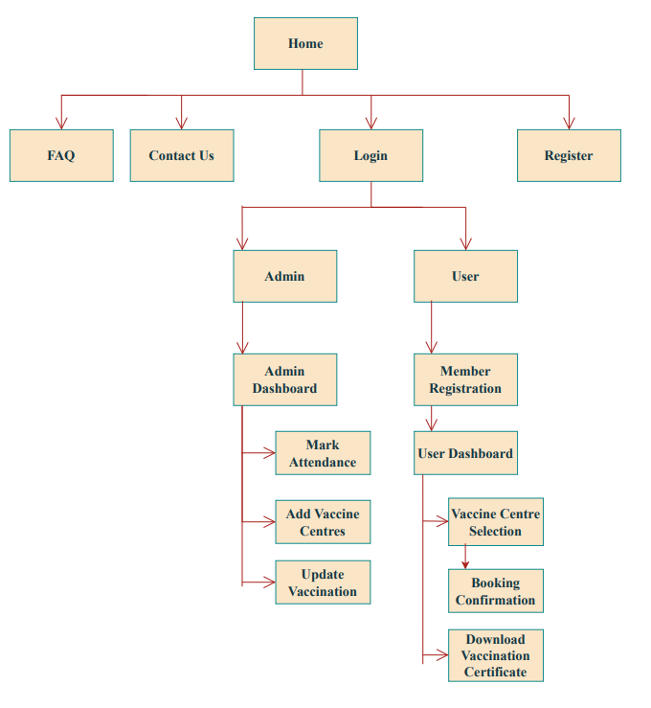
Project Overview
Fig 01: Project Overview

Slide 8
Objectives
This application has been build aiming to-
This system will be applicable for all the people with
inadequate idea about vaccines and their necessity.
The system will also help the hospital authorities to have
the exact idea about available patients and vaccines.
Authenticity of patient’s information as well as vaccines
information is assured which will lessen the chances of
mismanagement.

Slide 9
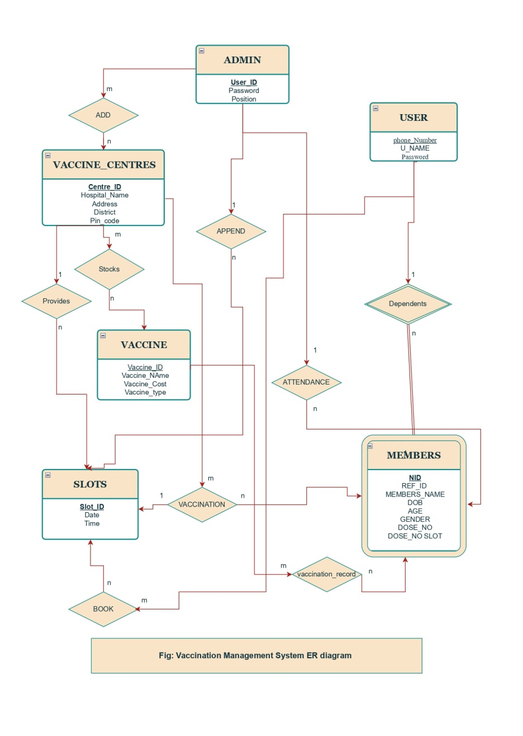
Final Database Design
Fig 02: ER Diagram

Slide 10
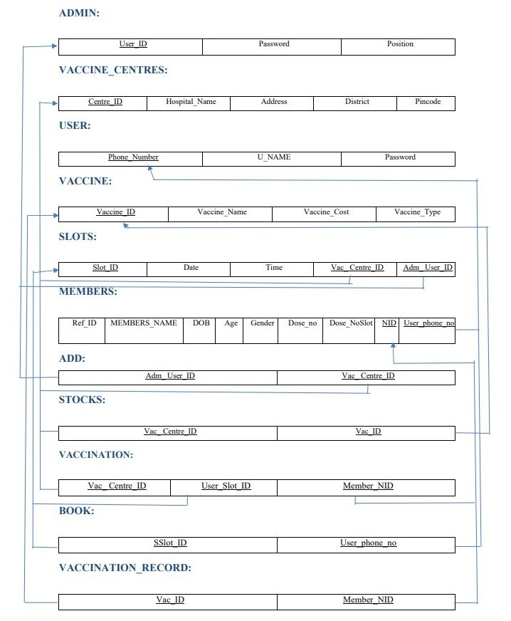
Final Database Design(Contd…)
Fig 03: Relational Mapping

Slide 11
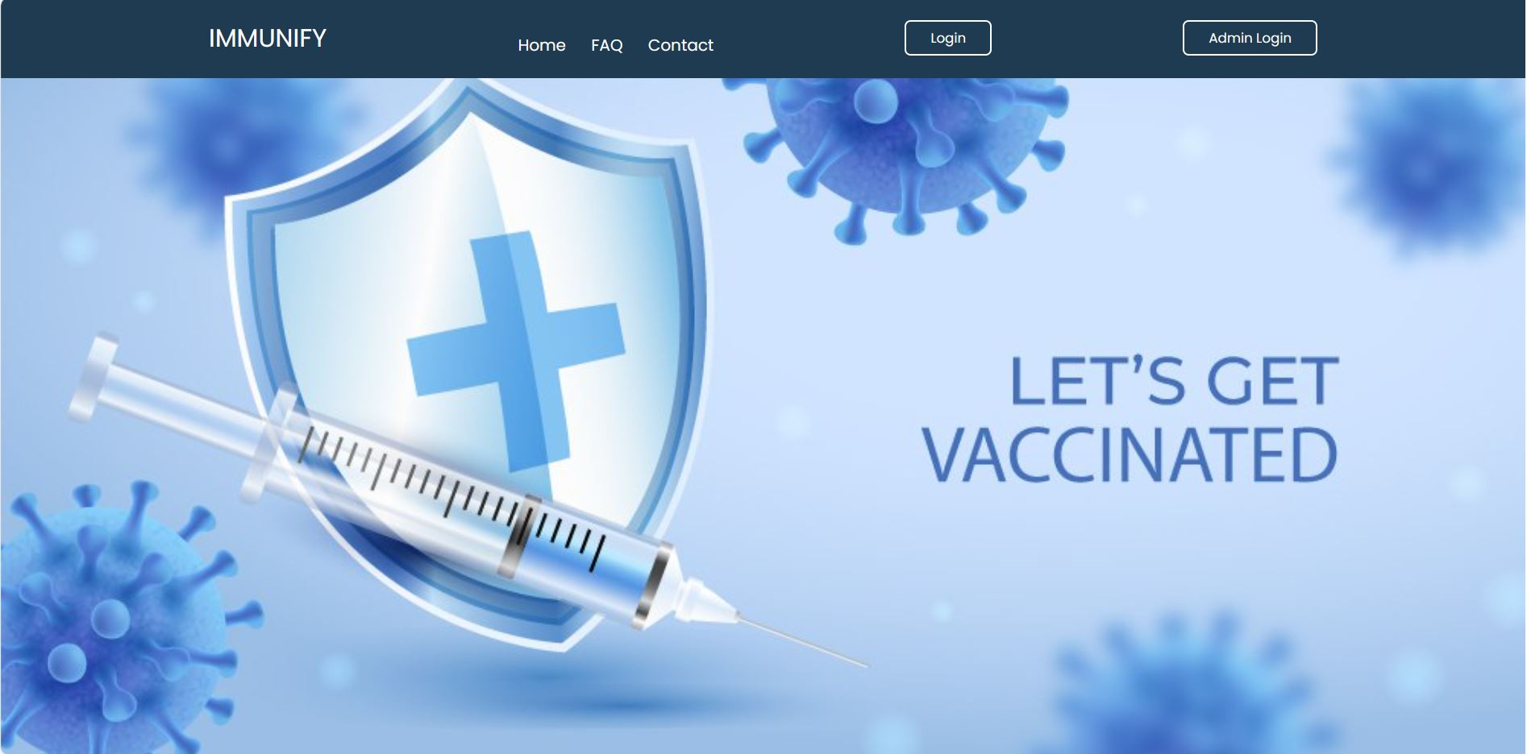
System Implementation
Home Page:
Fig 04: Home Page

Slide 12
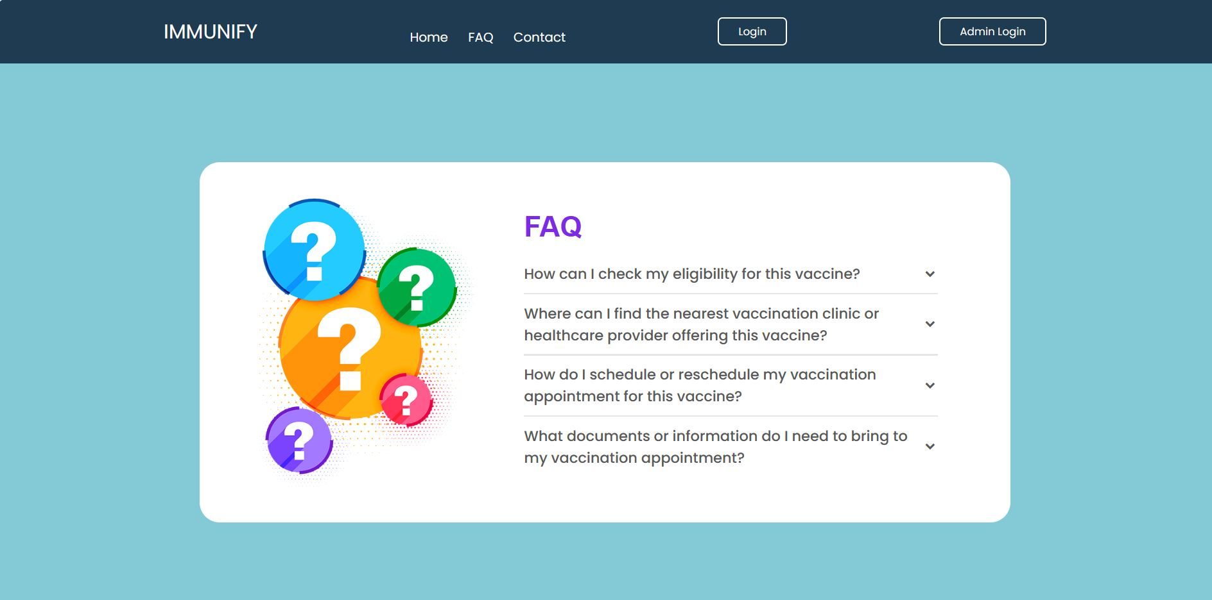
System Implementation(Contd…)
Home Page:
Fig 05: FAQ

Slide 13
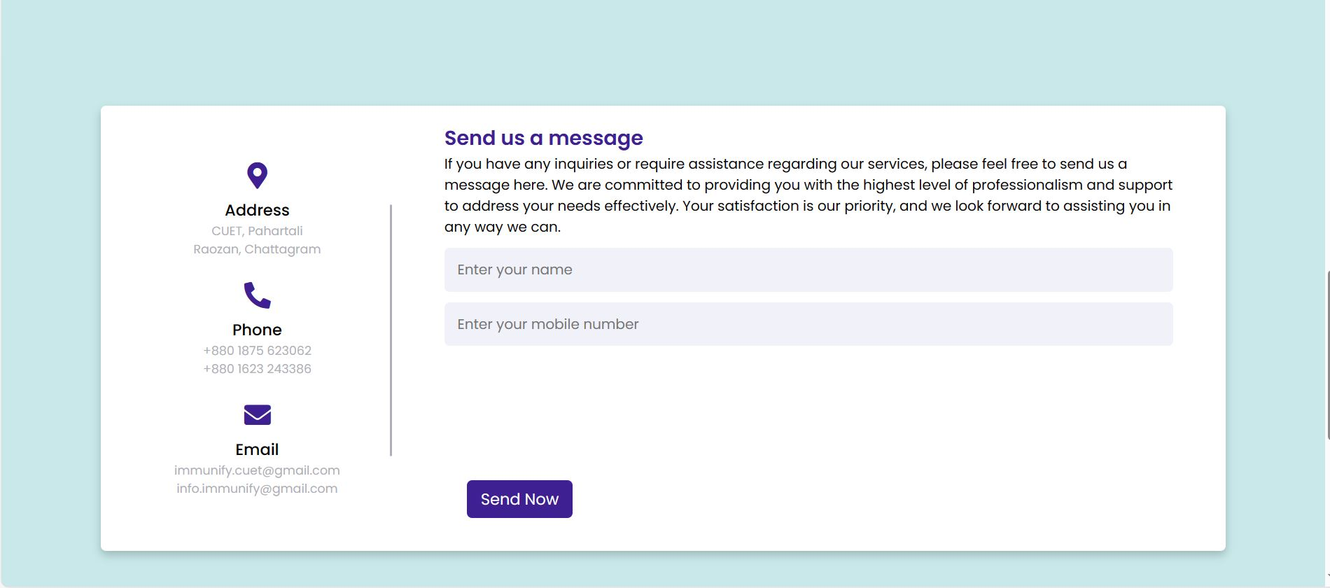
System Implementation(Contd…)
Home Page:
Fig 06: Contact Us

Slide 14
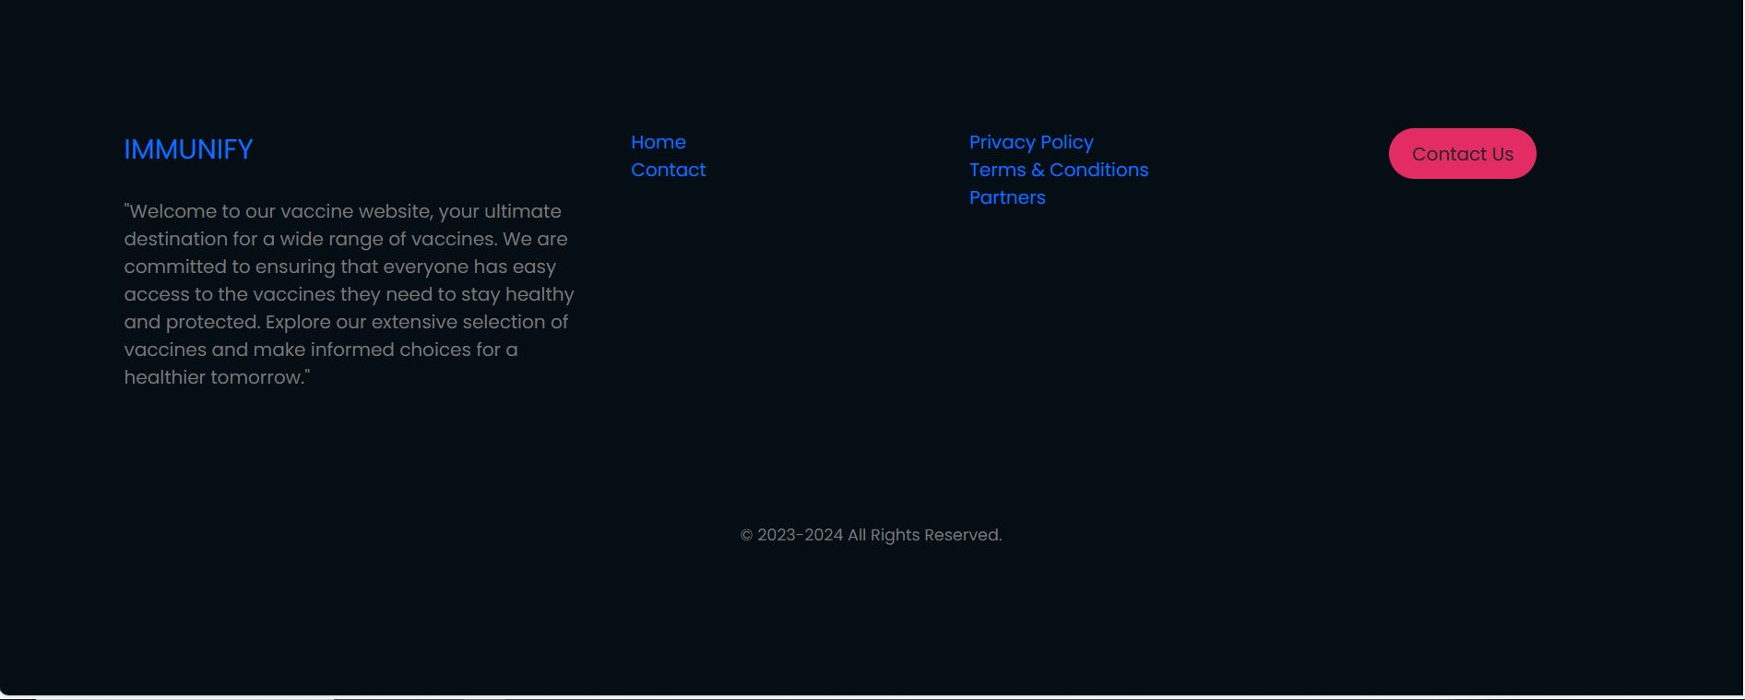
System Implementation(Contd…)
Home Page:
Fig 07: Footer of HomePage

Slide 15
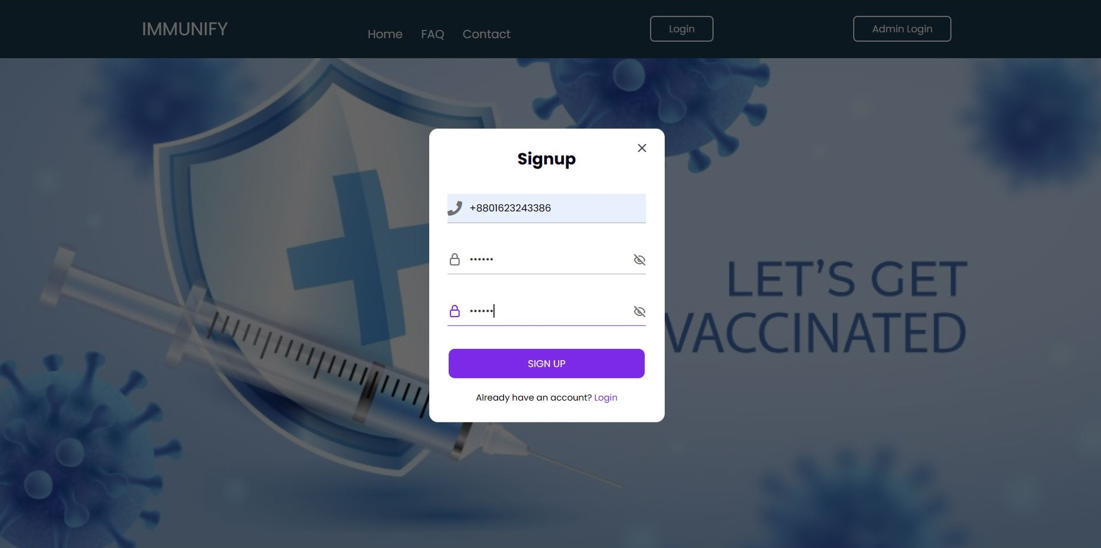
System Implementation(Contd…)
User Pages:
Fig 08: Register

Slide 16
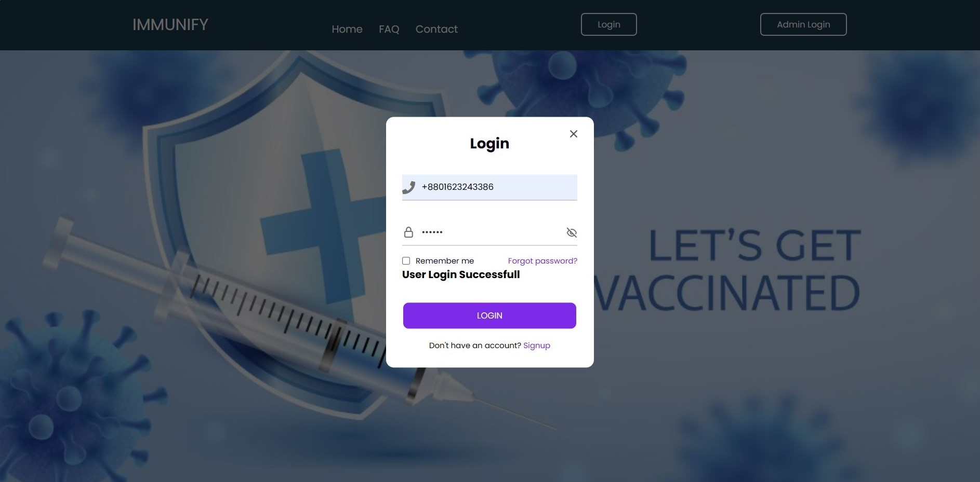
System Implementation(Contd…)
User Pages:
Fig 09: User Login

Slide 17
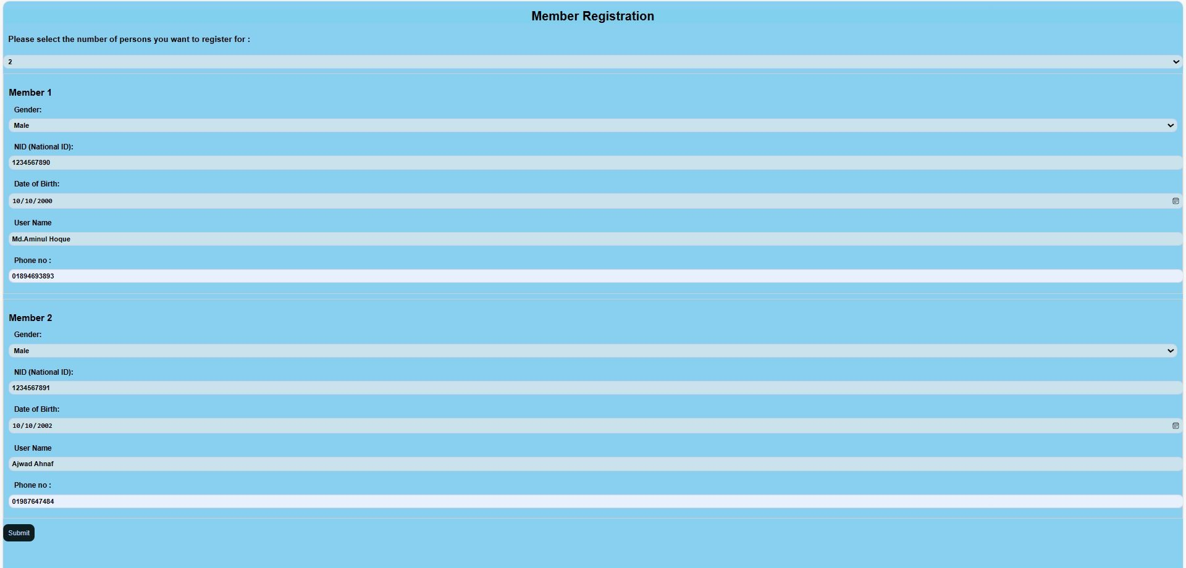
System Implementation(Contd…)
User Pages:
Fig 10: Member Registration

Slide 18
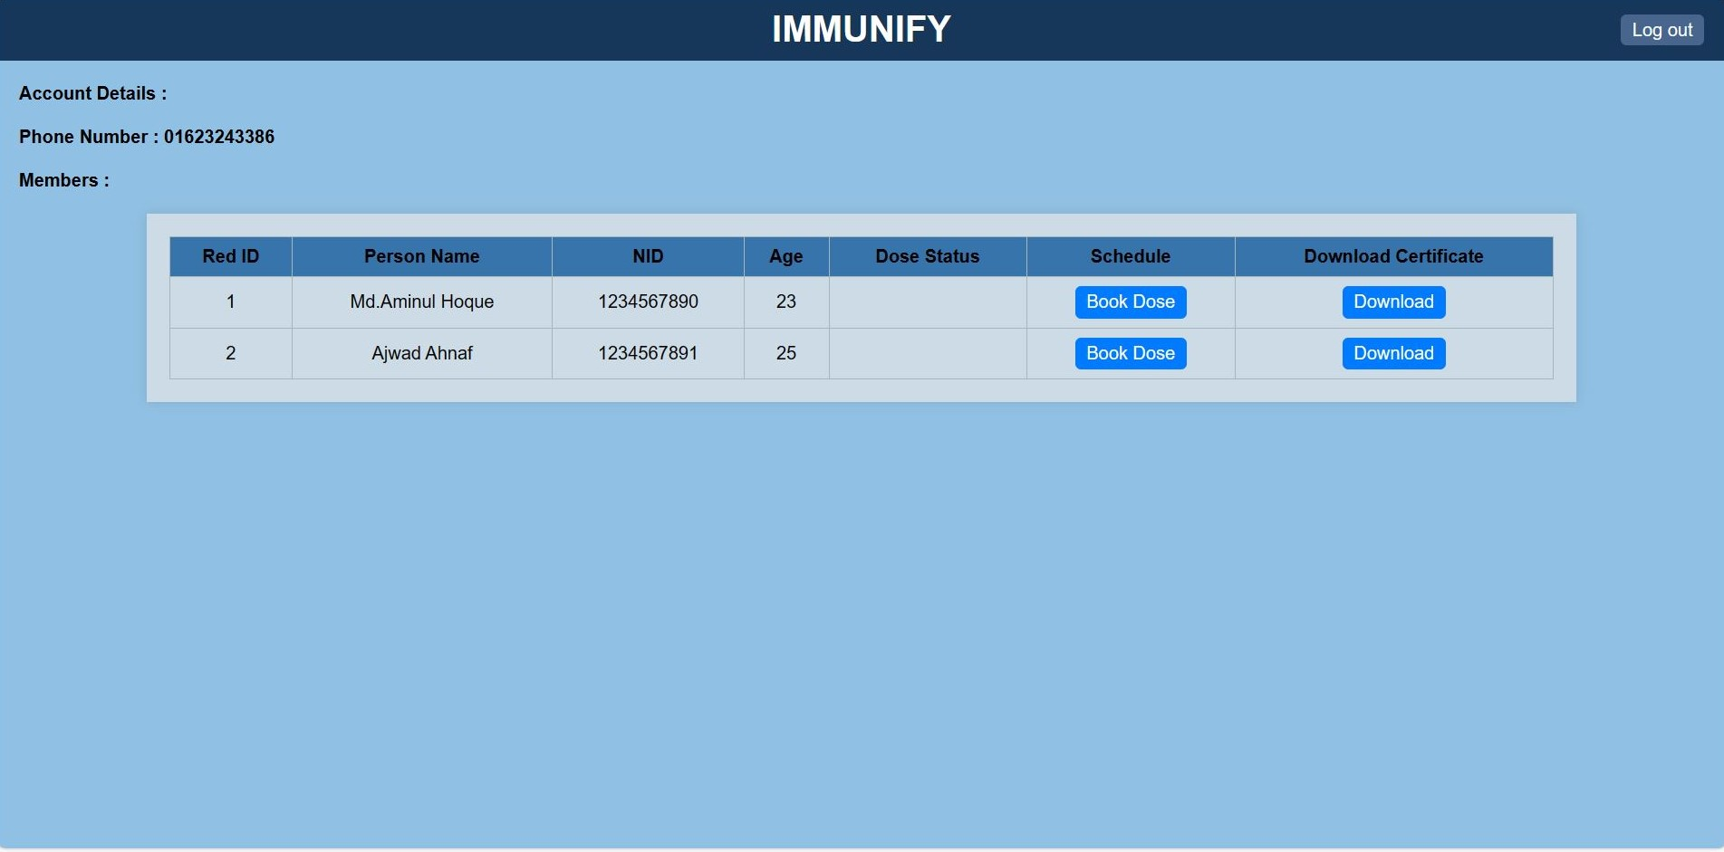
System Implementation(Contd…)
User Pages:
Fig 11: User Dashboard

Slide 19
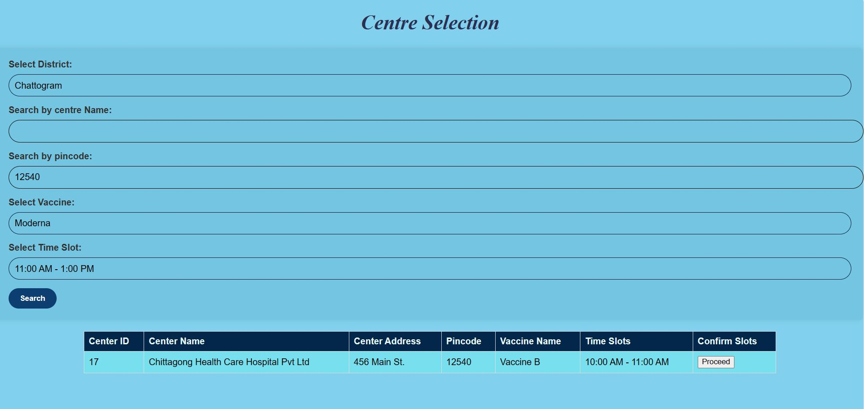
System Implementation(Contd…)
User Pages:
Fig 12: Centre Selection

Slide 20
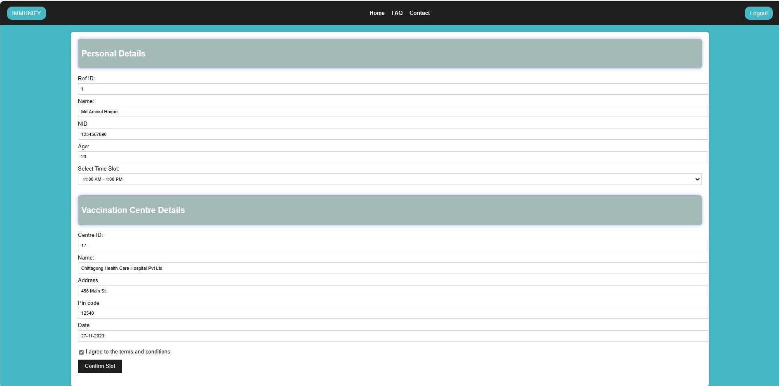
System Implementation(Contd…)
User Pages:
Fig 13: Booking Confirmation

Slide 21
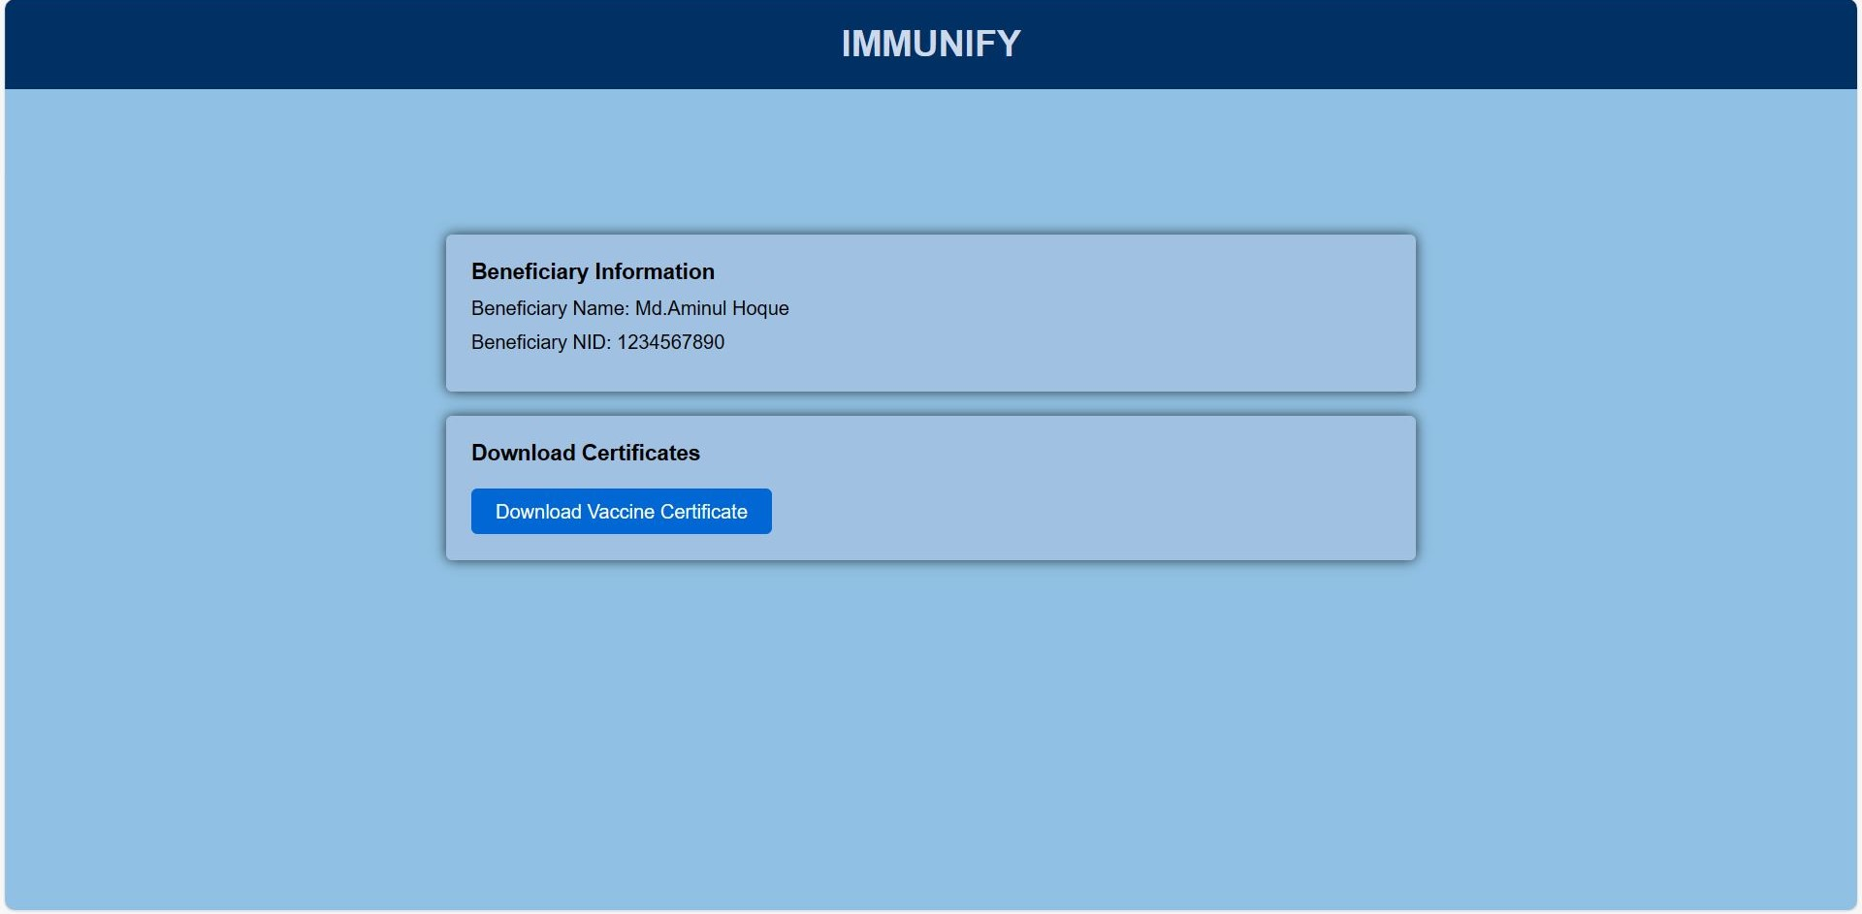
System Implementation(Contd…)
User Pages:
Fig 14: Download Certificate

Slide 22
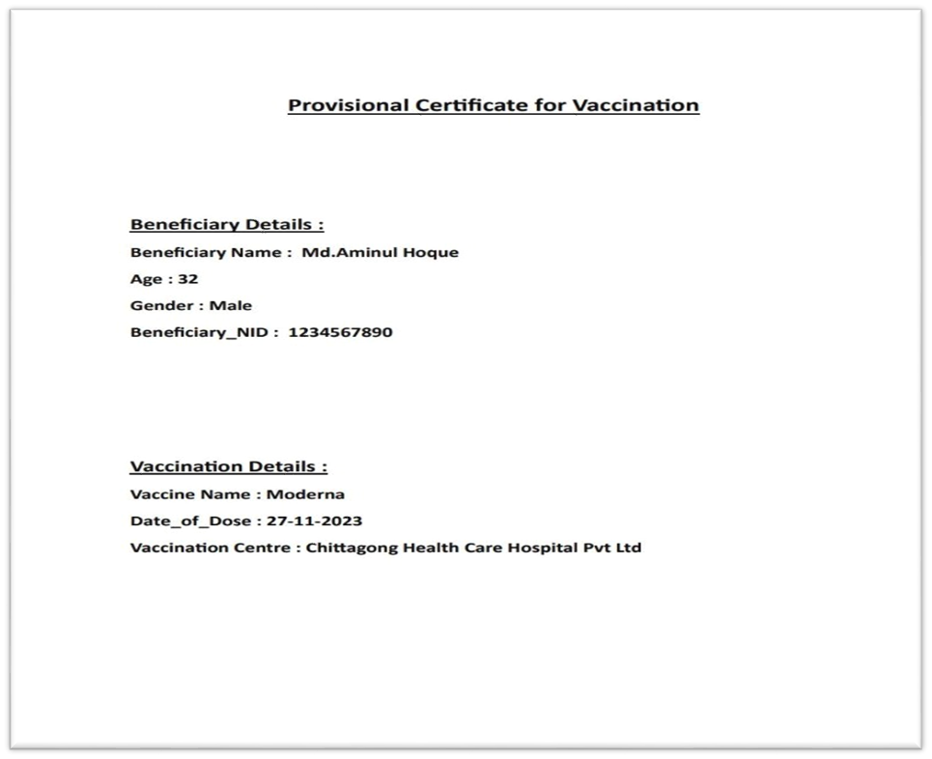
System Implementation(Contd…)
User Pages:
Fig 15: Certificate Of Vaccination

Slide 23
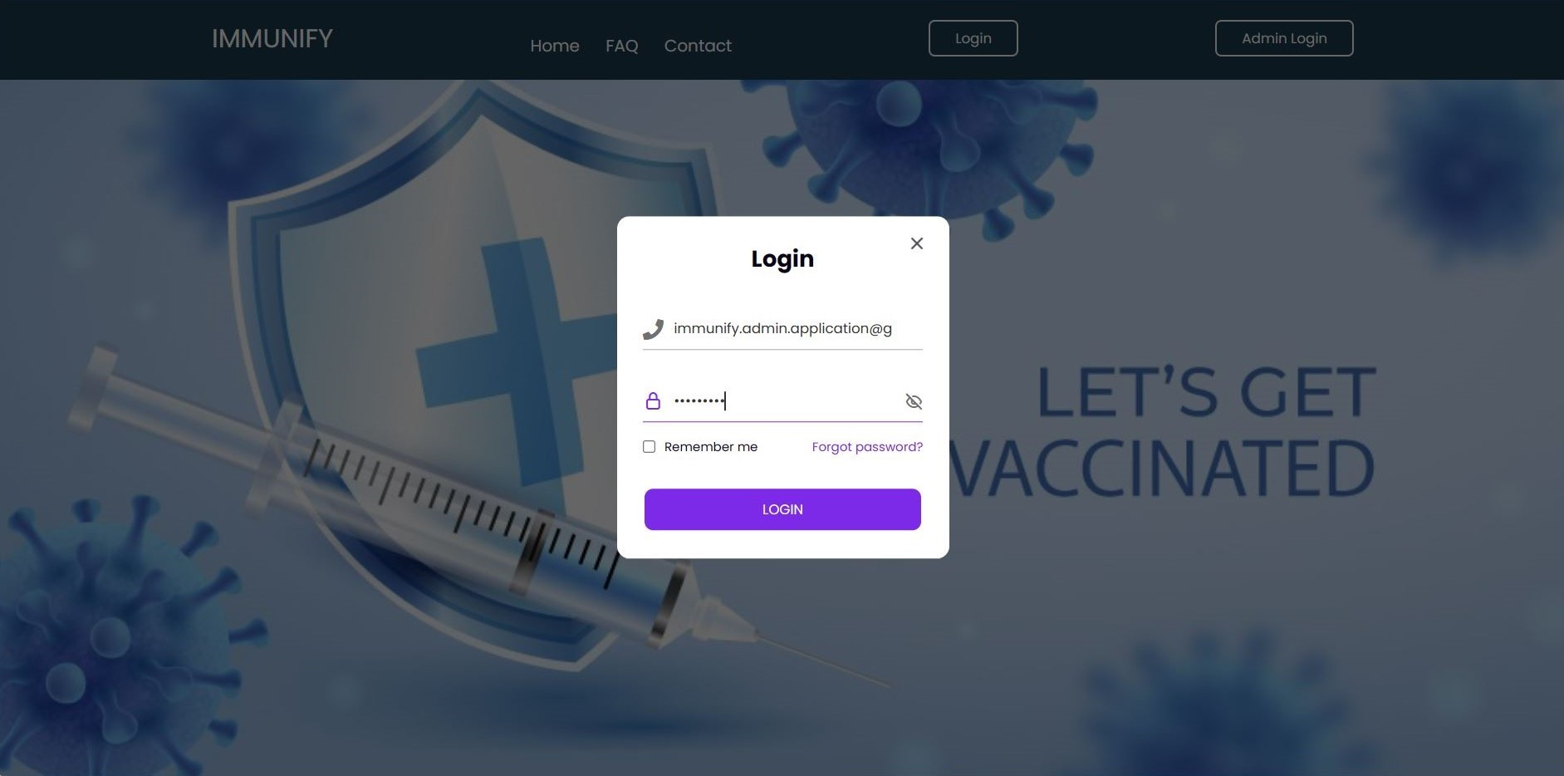
System Implementation(Contd…)
Admin Login Page:
Fig 16: Admin Login

Slide 24
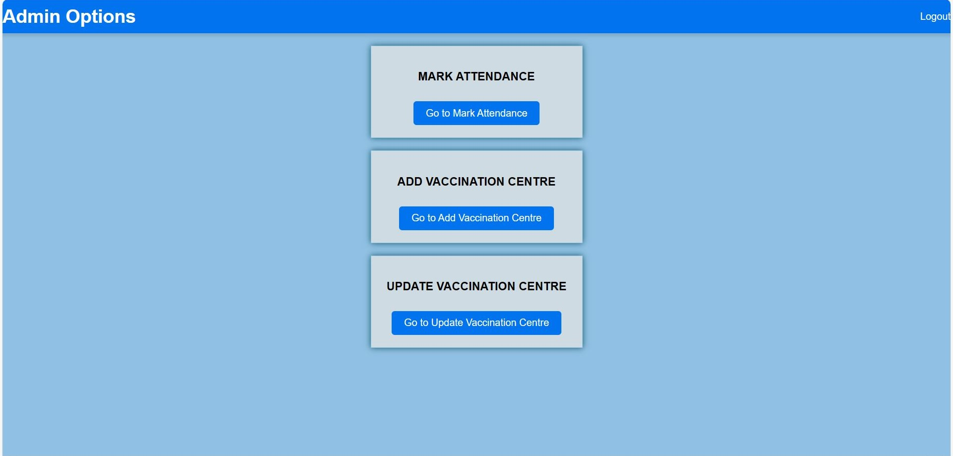
System Implementation(Contd…)
Admin Pages:
Fig 17: Admin Dashboard

Slide 25
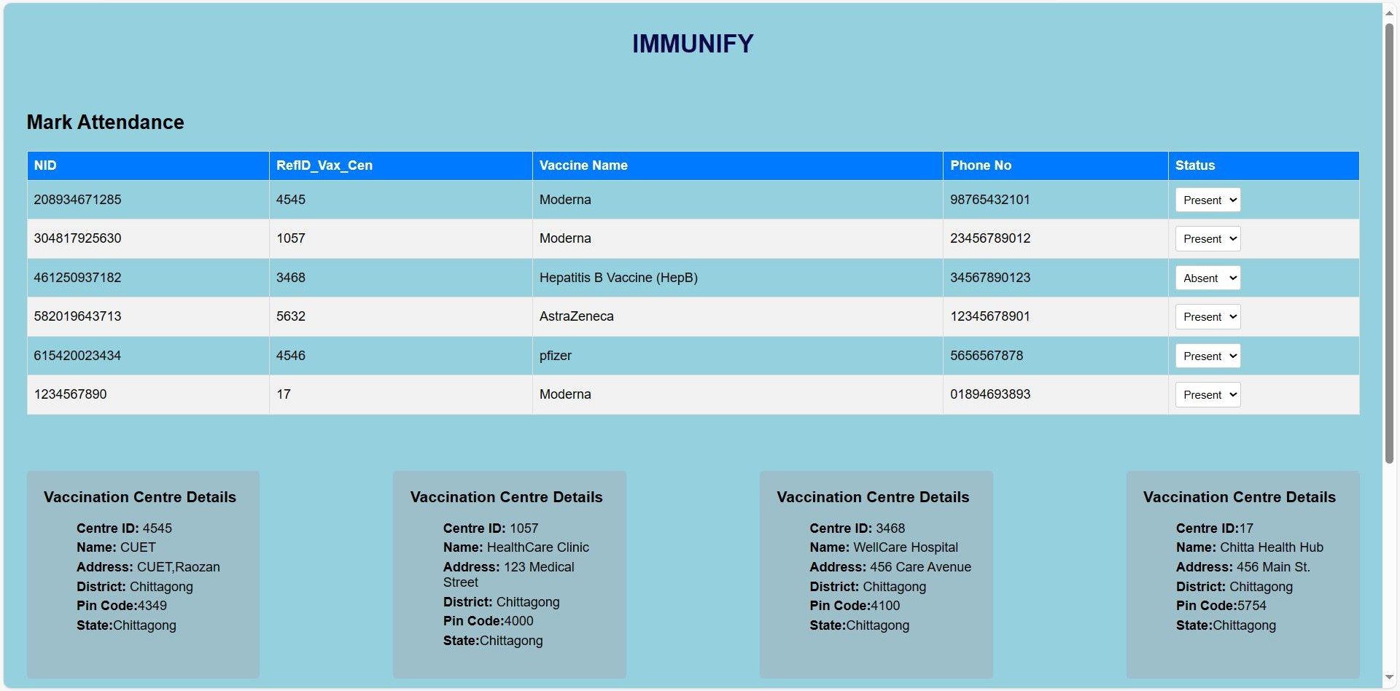
System Implementation(Contd…)
Admin Pages:
Fig 18: Mark Attendance

Slide 26
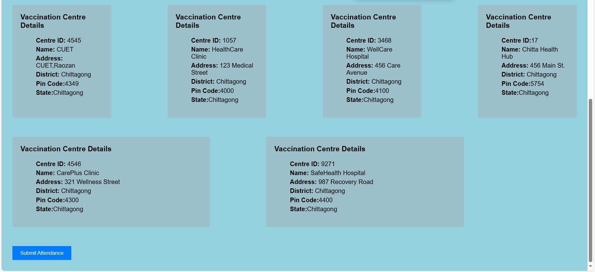
System Implementation(Contd…)
Admin Pages:
Fig 19: Mark Attendance

Slide 27
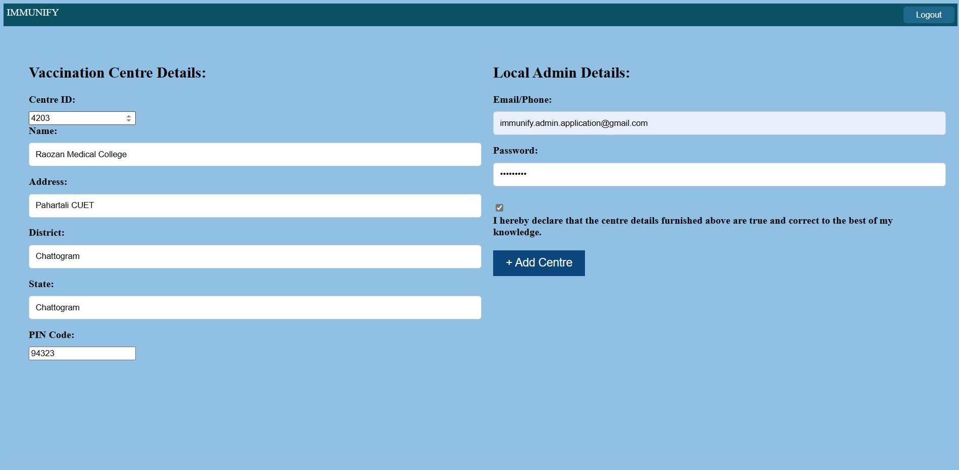
System Implementation(Contd…)
Admin Pages:
Fig 20: Add Vaccine Centre

Slide 28
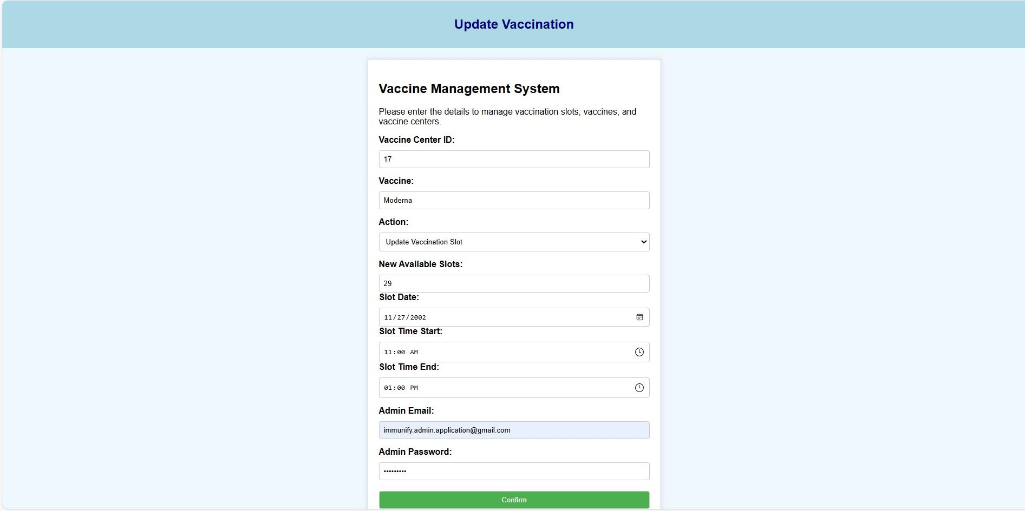
System Implementation(Contd…)
Admin Pages:
Fig 21: Update Vaccination Slot

Slide 29
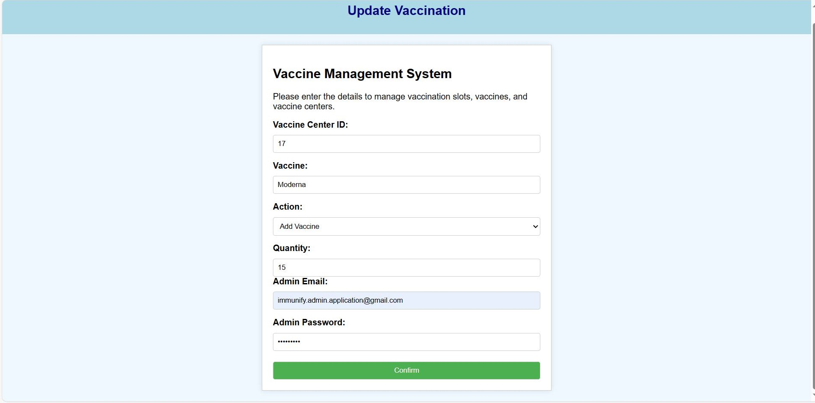
System Implementation(Contd…)
Admin Pages:
Fig 22: Add / Update Vaccine

Slide 30
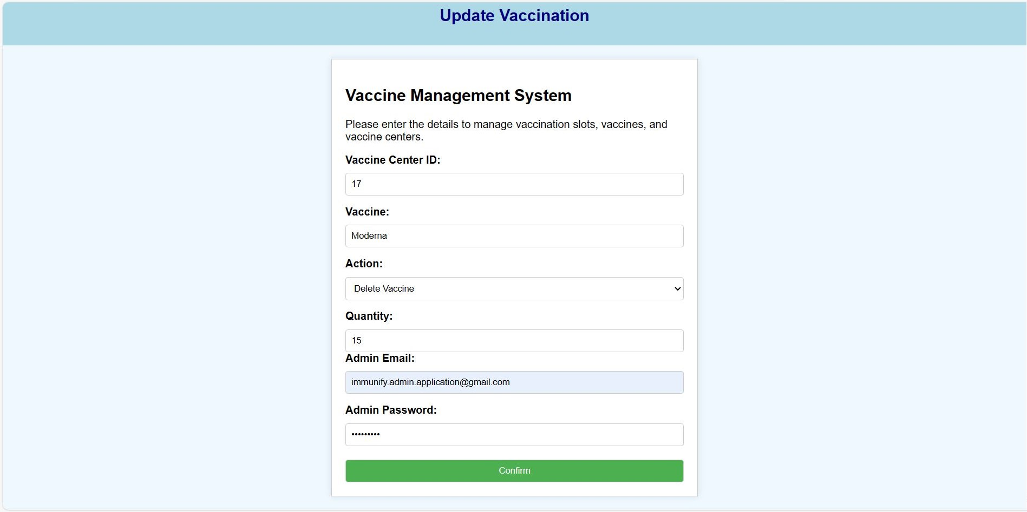
System Implementation(Contd…)
Admin Pages:
Fig 23: Delete Vaccine

Slide 31
Conclusion
To conclude, vaccination management system has potential
to-
Provide well-arranged information about vaccination and
healthcare system.
Reduce the death rate from infectious diseases like
Typhoid, Cholera, COVID-19 etc.
Organize things in a better way, so getting a vaccine will be smoother than now it is.
Reach out to everyone, including those who might have
trouble getting vaccines.

Slide 32
Thank You!

